Slide 1
STATIC WEBSITE HOSTING
PROJECT COMPLETION PRESENTATION

Slide 2
Project Information
Project Name: DayNight Terraform Infrastructure
Client / Business Unit: Precision Group, 'Ramakrishnan.Balasubramanian@precisionit.co.in'
Environment: UAT & Production
Cloud Platform: AWS
IaC Tool: Terraform
CI/CD Tool: AWS CodePipeline
Deployment Model: GitHub → CodePipeline → S3 → CloudFront
Project Duration: 2 days (48 hours)
Go-Live Date: 16th February 2026

Slide 3
Executive Summary
Implemented automated(CI/CD) codepipeline for static website hosting
Designed two-environment architecture (UAT → PROD)
Infrastructure fully provisioned using Terraform (IaC)
Secure CloudFront-based content delivery
Automated promotion workflow from UAT to PROD
Email-based approval mechanism for production deployment

Slide 4
Scope of Work (Delivered vs Planned)
Planned
UAT & PROD environment setup
S3 static website hosting
CloudFront distribution
CI/CD pipeline integration
SNS notifications
Lambda-based cache invalidation
Delivered
Fully automated Terraform-based infrastructure
UAT pipeline with manual approval stage
PROD pipeline without manual approval
SNS email notifications (Success / Failure / Approval)
CloudFront invalidation automation
Environment separation with remote state dependency

Slide 5
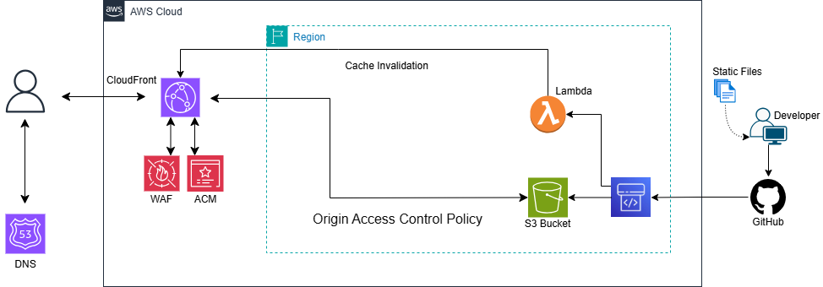
Architecture Overview and Diagram

Slide 6
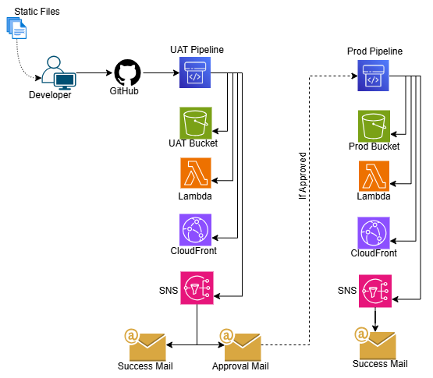
Architecture Overview and Diagram

Slide 7
Services Used
Terraform IaC
GitHub
AWS S3
SNS - Email
CodePipeline
CloudFront CDN
Lambda
EventBridge & IAM Roles

Slide 8
Architecture Overview and Diagram
S3 bucket for static hosting
CloudFront distribution with OAC
Lambda for cache invalidation
SNS for pipeline notifications
CodePipeline integrated with GitHub
Two isolated environments (UAT & PROD)

Slide 9
Security & Compliance Implementation
IAM least privilege roles
CloudFront Origin Access Control (OAC)
Private S3 bucket (no public access)
HTTPS-only access
Controlled pipeline execution
Tagging standards enforced
Manual approval for PROD promotion

Slide 10
Monitoring & Alerting Setup
SNS email notifications for pipeline events
Success notifications with CloudFront URL
Failure notifications with stage details
Approval request notification for PROD trigger
CloudWatch logs for Lambda
Default CloudWatch Dashboard
Infra-orchestrator.sh (Logs)

Slide 11
Testing & Validation
Terraform plan validation
UAT deployment testing
CloudFront content validation
Cache invalidation testing
Approval workflow validation
Production deployment verification

Slide 12
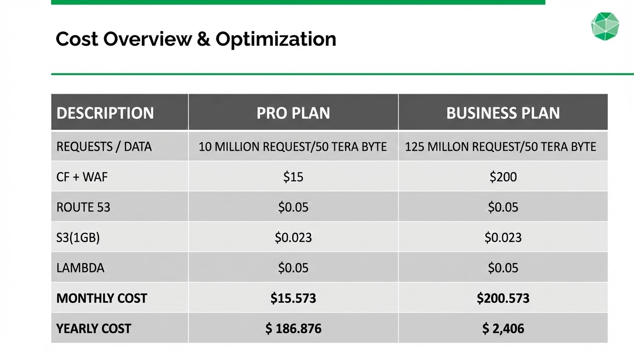

Slide 13
Known Limitations / Open Risks
Local Terraform backend used
PROD depends on UAT state file
Manual SNS subscription confirmation required
No multi-region DR setup
Monitoring limited to pipeline notifications

Slide 14
Thank You

